Slide 1



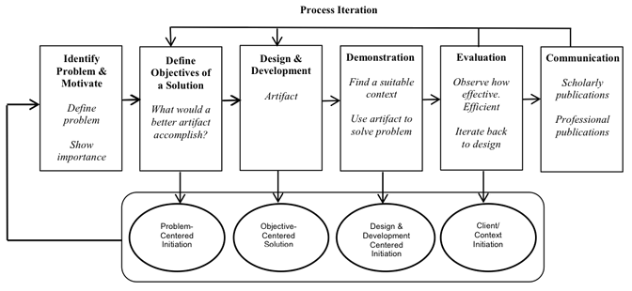
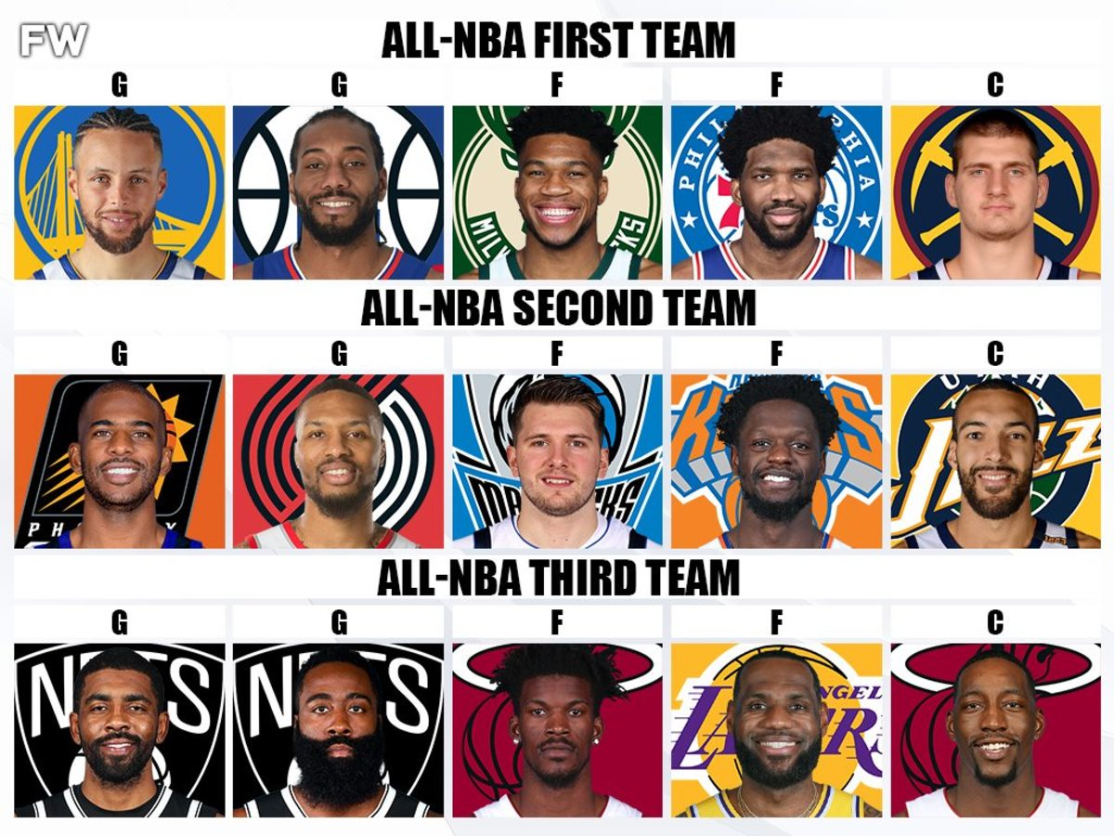


Project Introduction
Project overview and purpose.
Introduction of team members.
ML Methodology Explanation
Why oversampled decision tree was chosen
Confusion Matrices for each model.
Ranked Sorted Feature Importance
Bar Chart of of model’s Feature Importance.
Interactive filter by player position
ML Model’s All-NBA Predictions
Predicted players for each position.
Full rosters for 1st, 2nd, and 3rd All-NBA Team.
Prediction Results Comparison
Comparing ML rosters vs. actual rosters.
User can choose which year to compare.
User Inputted Player Prediction
User inputs season stats for a dummy player.
ML predicts if player makes any All-NBA Team.

